Slide 1
Extra slides: Access Control Lists IPv6
Notes:
Cisco Networking Academy Program
Connecting Networks v6.0
Chapter 4: Access Control Lists

Slide 2
1. IPv6 ACLs Configuration
Notes:
4 – Access Control Lists
4.3 – IPv6 ACLs

Slide 3
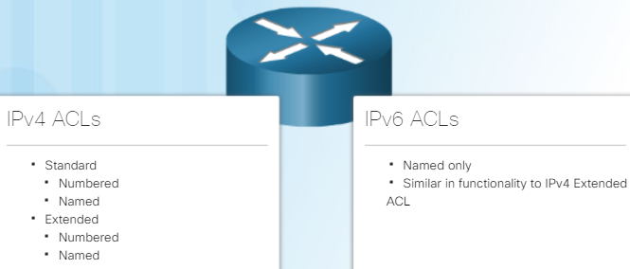
IPv6 ACLs IPv6 ACL Creation
IPv6 ACLs are similar to IPv4 ACLs in both operation and configuration.
Note:
An IPv4 ACL and an IPv6 ACL cannot share the same name.
In IPv4 there are two types of ACLs, standard and extended and both types of ACLs can be either numbered or named ACLs.
With IPv6, there is only one type of ACL, which is equivalent to an IPv4 extended named ACL and there are no numbered ACLs in IPv6.
Notes:
4.3 – IPv6 ACLs
4.3.1 – IPv6 ACL Creation
4.3.1.1 – Types of IPv6 ACLs

Slide 4
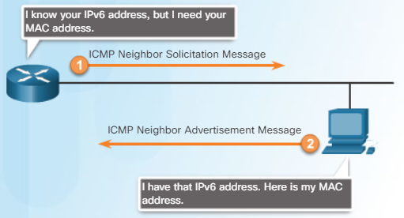
IPv6 ACLs IPv6 ACL Creation
There are three significant differences between IPv4 and IPv6 ACLs:
The command used to apply an IPv6 ACL to an interface is ipv6 traffic-filter command.
IPv6 ACLs do not use wildcard masks but instead specifies the prefix-length to indicate how much of an IPv6 source or destination address should be matched.
Additional Default Statements
At the end of IPv4 (standard or extended) ACL: implicit deny any or deny ip any any.
IPv6 includes a similar deny ipv6 any any statement at the end
+ two other implicit statements by default:
permit icmp any any nd-na
permit icmp any any nd-ns
IPv6 uses ICMP Neighbor Discovery (ND) messages (Neighbor Solicitation (NS) and Neighbor Advertisement (NA) to accomplish what ARP does in IPv4.
ND messages are encapsulated in IPv6 packets and thus using the Layer 3 service for neighbor discovery. Therefore, IPv6 ACLs need to implicitly permit ND packets to be sent and received on an interface. Specifically, both Neighbor Discovery - Neighbor Advertisement (nd-na) and Neighbor Discovery - Neighbor Solicitation (nd-ns) messages need to be permitted
Notes:
4.3 – IPv6 ACLs
4.3.1 – IPv6 ACL Creation
4.3.1.2 – Comparing IPv4 and IPv6 ACLs

Slide 5
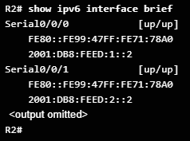
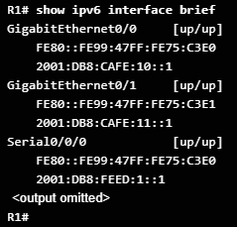
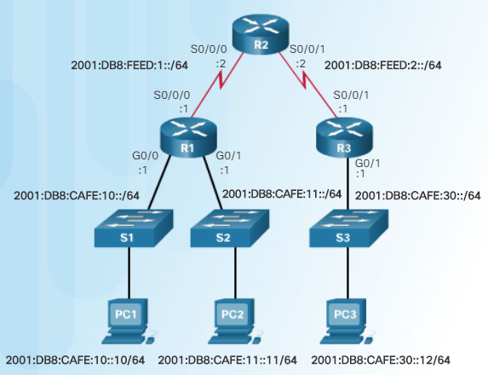
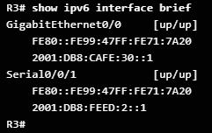
IPv6 ACLs Configuring IPv6 ACLs
The following is the sample topology that will be used to demonstrate IPv6 ACLs.
All interfaces are configured and active.
Notes:
4.3 – IPv6 ACLs
4.3.2 – Configuring IPv6 ACLs
4.3.2.1 – Configuring IPv6 Topology

Slide 6
IPv6 ACLs Configuring IPv6 ACLs
In IPv6 there are only named ACLs and the configuration is similar to IPv4 extended named ACLs. Like IPv4 named ACLs, IPv6 names are alphanumeric, case sensitive, and must be unique. Unlike IPv4, there is no need for a standard or extended option.
There are three basic steps to configure an IPv6 ACL:
From global configuration mode, use the ipv6 access-list name command to create an IPv6 ACL. IPv6 names are alphanumeric, case sensitive, and must be unique. Unlike IPv4, there is no need for a standard or extended option.
From the named ACL configuration mode, use permit or deny statements to specify one or more conditions to determine if a packet is forwarded or dropped.
Return to privileged EXEC mode
Notes:
4.3 – IPv6 ACLs
4.3.2 – Configuring IPv6 ACLs
4.3.2.2 – Configuring IPv6 ACLs

Slide 7

IPv6 ACLs Configuring IPv6 ACLs
In this example:
The 1st statement names the IPv6 ACL NO-R3-LAN-ACCESS.
The 2nd statement denies all IPv6 packets from the 2001:DB8:CAFE:30::/64 destined for any IPv6 network.
The 3rd statement allows all other IPv6 packets.
Notes:
4.3 – IPv6 ACLs
4.3.2 – Configuring IPv6 ACLs
4.3.2.2 – Configuring IPv6 ACLs

Slide 8
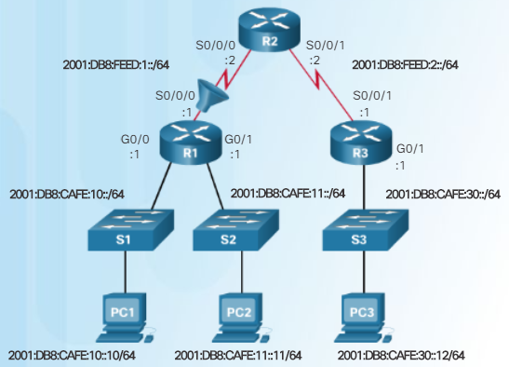

IPv6 ACLs Configuring IPv6 ACLs
After an IPv6 ACL is configured, it is linked to an interface using the following interface command:
ipv6 traffic-filter access-list-name {in | out}
The command applies the NO-R3-LAN-ACCESS IPv6 ACL inbound to the S0/0/0 interface of R1.
To remove an IPv6 ACL, enter the no ipv6 traffic-filter command on the interface, and then enter the global no ipv6 access-list command to remove the access list.
Note that IPv4 and IPv6 both use the access-class command to apply an access list to VTY ports.
Notes:
4.3 – IPv6 ACLs
4.3.2 – Configuring IPv6 ACLs
4.3.2.3 – Applying an IPv6 ACL to an Interface

Slide 9
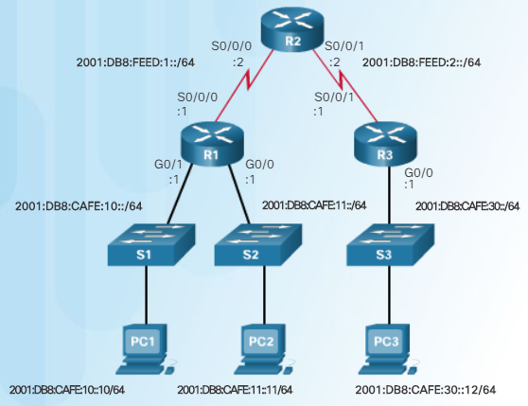
IPv6 ACLs Configuring IPv6 ACLs
In this example, an IPv6 ACL permits R3 LAN users limited access to the LANs on R1.
These ACES allow access from any device to the web server (2001:DB8:CAFE:10::10).
All other devices are denied access to the 2001:DB8:CAFE:10::/64 network.
PC3 (2001:DB8:CAFE:30::12) is permitted Telnet access to PC2 (2001:DB8:CAFE:11::11).
All others are denied Telnet access to PC2.
All other IPv6 traffic is permitted to all other destinations.
The IPv6 access list is applied inbound on G0/0 so only the 2001:DB8:CAFE:30::/64 network is affected.
Notes:
4.3 – IPv6 ACLs
4.3.2 – Configuring IPv6 ACLs
4.3.2.4 – IPv6 ACL Examples

Slide 10
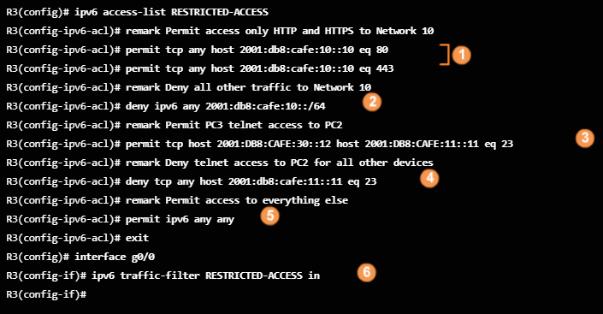
IPv6 ACLs Configuring IPv6 ACLs
These ACES allow access from any device to the web server (2001:DB8:CAFE:10::10).
All other devices are denied access to the 2001:DB8:CAFE:10::/64 network.
PC3 (2001:DB8:CAFE:30::12) is permitted Telnet access to PC2 (2001:DB8:CAFE:11::11).
All others are denied Telnet access to PC2.
All other IPv6 traffic is permitted to all other destinations.
Notes:
4.3 – IPv6 ACLs
4.3.2 – Configuring IPv6 ACLs
4.3.2.4 – IPv6 ACL Examples

Slide 11
IPv6 ACLs Configuring IPv6 ACLs
In this example, an IPv6 ACL permits R3 LAN users limited access to the LANs on R1.
6. The IPv6 access list is applied inbound on G0/0 so only the 2001:DB8:CAFE:30::/64 network is affected.
Notes:
4.3 – IPv6 ACLs
4.3.2 – Configuring IPv6 ACLs
4.3.2.4 – IPv6 ACL Examples

Slide 12
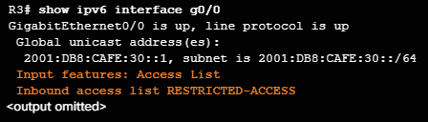
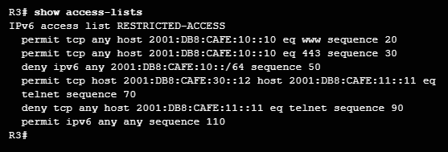
IPv6 ACLs Configuring IPv6 ACLs
The commands used to verify an IPv6 access list are similar to those used for IPv4 ACLs.
The show running-config command displays all of the ACEs and remark statements.
Use the show ipv6 interface command to see which ACL and direction is configured on an interface.
Use the show access-lists command displays all configured IPv4 and IPv6 access lists
Notice that IPv6 ACL sequence numbers are displayed at the end of the ACE.
Although the statements appear in the order they were entered, they are not always incremented by 10. This is because the remark statements that were entered use a sequence number but are not displayed in the output of the show access-lists command.
Similar to extended ACLs for IPv4, IPv6 access lists are displayed and processed in the order the statements are entered.
Notes:
4.3 – IPv6 ACLs
4.3.2 – Configuring IPv6 ACLs
4.3.2.5 – Verifying IPv6 ACLs

Slide 13
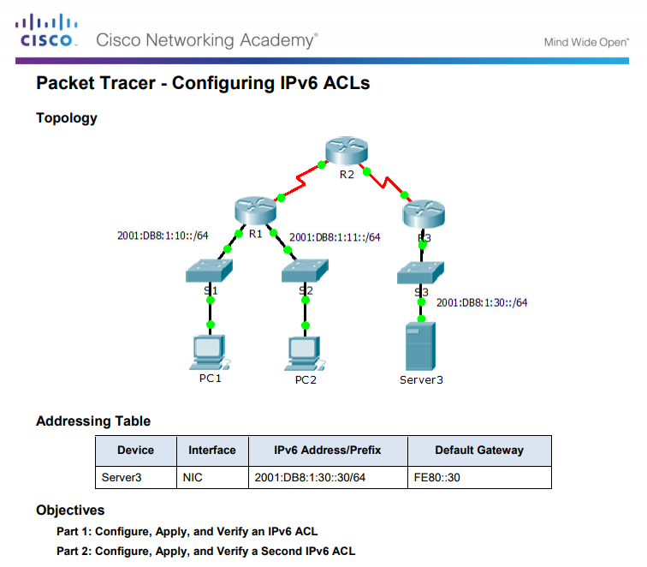
IPv6 ACLs Configuring IPv6 ACLs
Notes:
4.3 – IPv6 ACLs
4.3.2 – Configuring IPv6 ACLs
4.3.2.6 – Packet Tracer - Configuring IPv6 ACLs

Slide 14
2 Troubleshoot IPv6 ACLs
Notes:
4 – Access Control Lists
4.4 – Troubleshoot ACLs

Slide 15
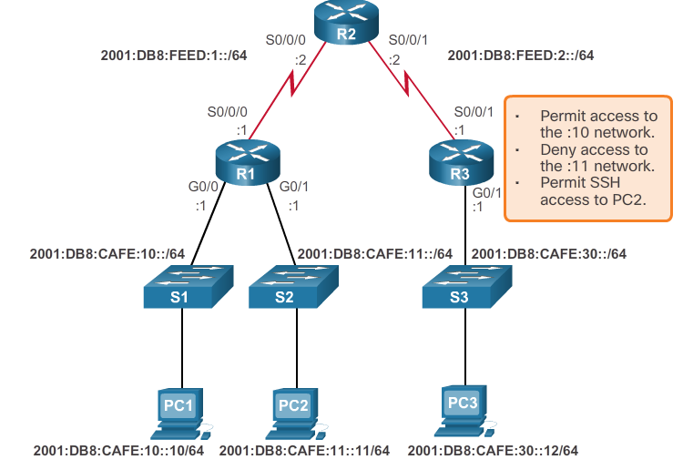
Common ACL Errors Troubleshooting IPv6 ACLs- Example 2
R3 is configured with IPv6 ACL RESTRICTED-ACCESS that should enforce the following policy for the R3 LAN:
However, after configuring the ACL, PC3 cannot reach the 10 network or the 11 network, and it cannot SSH into the host at 2001:DB8:CAFE:11::11.
Notes:
4.4 – Troubleshoot ACLs
4.4.2 – Common ACL Errors
4.4.2.7 – Troubleshooting IPv6 ACLs – Example 2

Slide 16
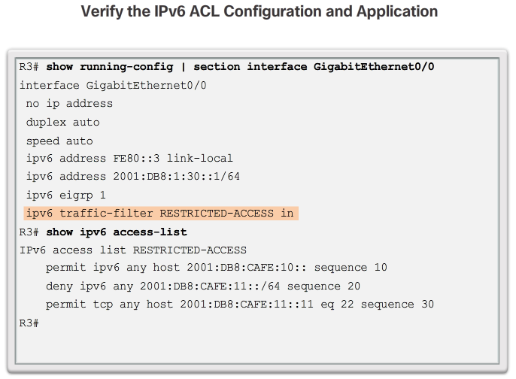
Common ACL Errors Troubleshooting IPv6 ACLs- Example 2 (cont.)
Notes:
4.4 – Troubleshoot ACLs
4.4.2 – Common ACL Errors
4.4.2.7 – Troubleshooting IPv6 ACLs – Example 2

Slide 17
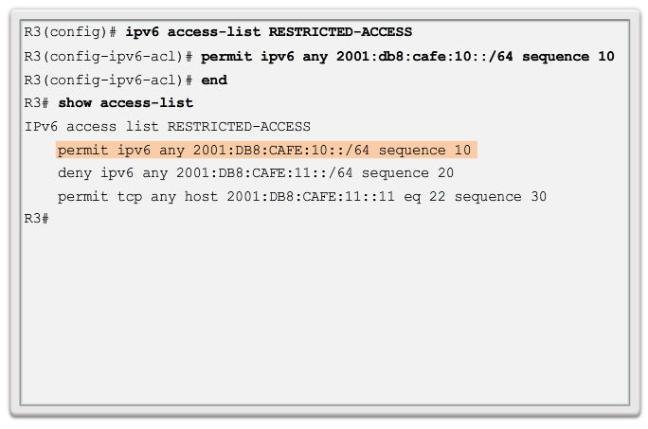
Common ACL Errors Troubleshooting IPv6 ACLs- Example 2 (cont.)
Notes:
4.4 – Troubleshoot ACLs
4.4.2 – Common ACL Errors
4.4.2.7 – Troubleshooting IPv6 ACLs – Example 2

Slide 18
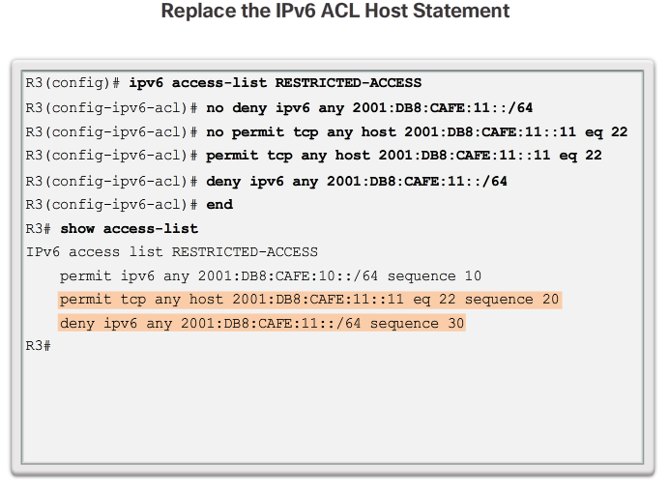
Common ACL Errors Troubleshooting IPv6 ACLs- Example 2 (cont.)
Notes:
4.4 – Troubleshoot ACLs
4.4.2 – Common ACL Errors
4.4.2.7 – Troubleshooting IPv6 ACLs – Example 2

Slide 19
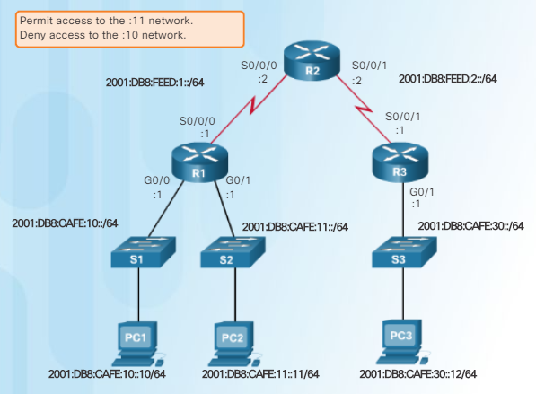
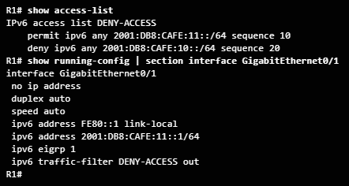
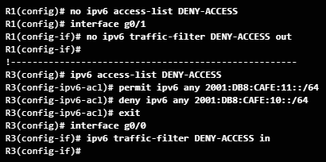
Troubleshoot ACLs Common ACLs Errors
In this example, R1 is configured with an IPv6 ACL named DENY-ACCESS that should permit access to the :11 network from the :30 network, but deny access to the :10 network.
The DENY-ACCESS ACL is supposed to permit access to the :11 network from the :30 network while denying access to the :10 network.
However, after applying the ACL to the interface the :10 network is still reachable from the :30 network.
Solution:
The problem is with the location of the ACL and should be applied closest to the source of the traffic.
Remove the ACL on R1 and apply the ACL on R3.
Notes:
4.4 – Troubleshoot ACLs
4.4.2 – Common ACLs Errors
4.4.2.8 – Troubleshooting IPv6 ACLs – Example 3

Slide 20
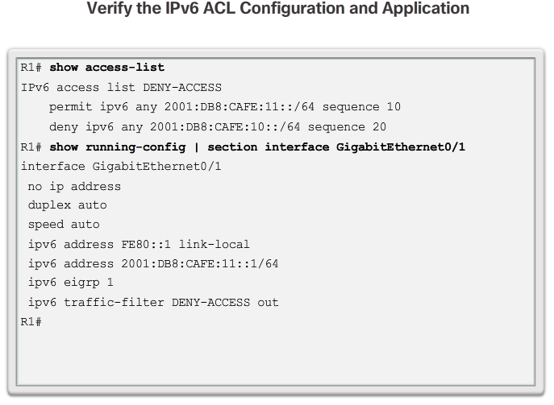
Common ACL Errors Troubleshooting IPv6 ACLs- Example 3 (cont.)
Notes:
4.4 – Troubleshoot ACLs
4.4.2 – Common ACL Errors
4.4.2.8 – Troubleshooting IPv6 ACLs – Example 3

Slide 21
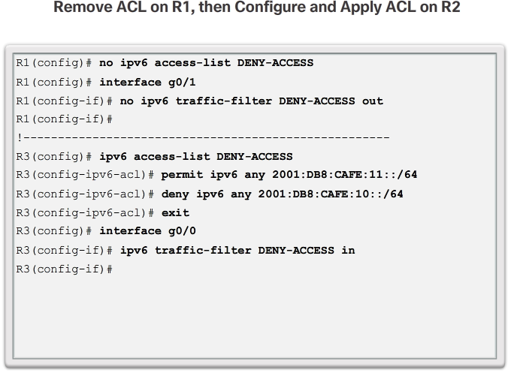
Common ACL Errors Troubleshooting IPv6 ACLs- Example 3 (cont.)
Notes:
4.4 – Troubleshoot ACLs
4.4.2 – Common ACL Errors
4.4.2.8 – Troubleshooting IPv6 ACLs – Example 3

Slide 22
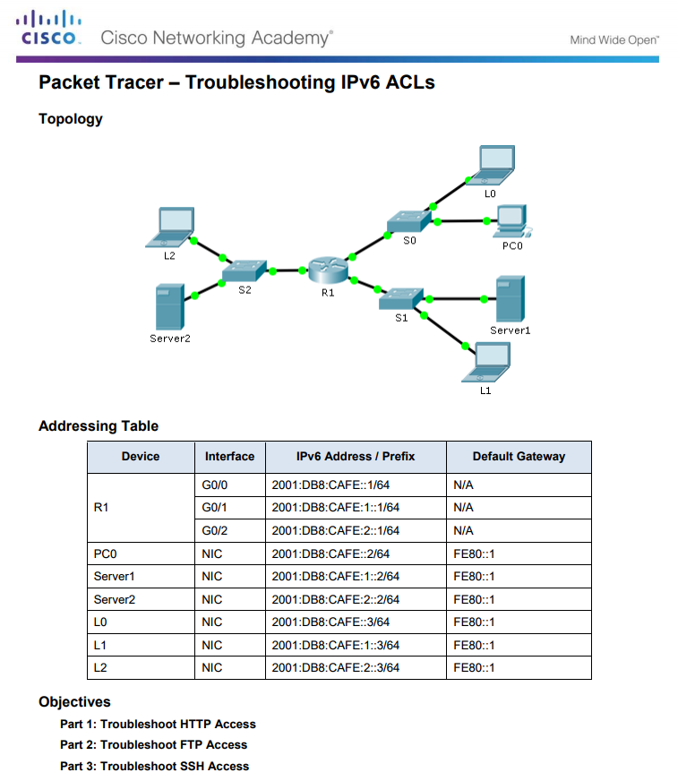
Troubleshoot ACLs Common ACLs Errors
Notes:
4.4 – Troubleshoot ACLs
4.4.2 – Common ACLs Errors
4.4.2.10 – Packet Tracer - Troubleshooting IPv6 ACLs

